Slide 1
Intel 8086 MICROPROCESSOR

Slide 2
Features
It is a 16-bit μp.
8086 has a 20 bit address bus can access up to 2²⁰ memory locations (1 MB).
It can support up to 64K I/O ports.
It provides 14, 16 -bit registers.
Word size is 16 bits.
It has multiplexed address and data bus AD0- AD15 and A16 – A19.
It requires single phase clock with 33% duty cycle to provide internal timing.

Slide 3
8086 is designed to operate in two modes, Minimum and Maximum.
It can prefetches up to 6 instruction bytes from memory and queues them in order to speed up instruction execution.
It requires +5V power supply.
A 40 pin dual in line package.
Address ranges from 00000H to FFFFFH
Memory is byte addressable - Every byte has a separate address.

Slide 4
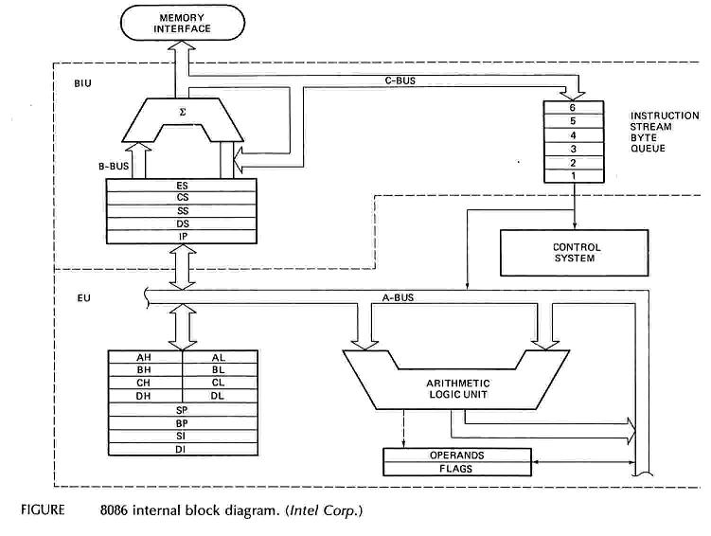
Intel 8086 Internal Architecture

Slide 5
Internal architecture of 8086
8086 has two blocks BIU and EU.
The BIU handles all transactions of data and addresses on the buses for EU.
The BIU performs all bus operations such as instruction fetching, reading and writing operands for memory and calculating the addresses of the memory operands. The instruction bytes are transferred to the instruction queue.
EU executes instructions from the instruction system byte queue.

Slide 6
Both units operate asynchronously to give the 8086 an overlapping instruction fetch and execution mechanism which is called as Pipelining. This results in efficient use of the system bus and system performance.
BIU contains Instruction queue, Segment registers, Instruction pointer, Address adder.
EU contains Control circuitry, Instruction decoder, ALU, Pointer and Index register, Flag register.

Slide 7
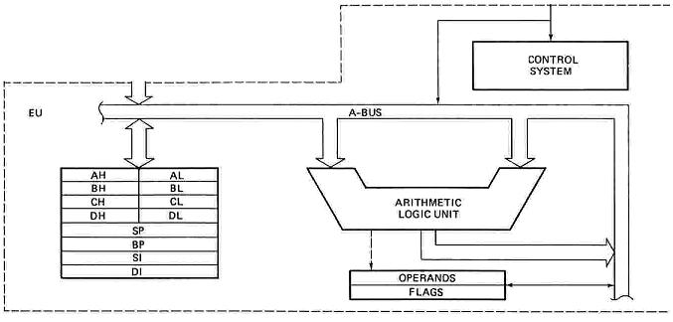
EXECUTION UNIT
Decodes instructions fetched by the BIU
Generate control signals,
Executes instructions.
The main parts are:
Control Circuitry
Instruction decoder
ALU

Slide 8
EXECUTION UNIT – General Purpose Registers
16 bits
16 bits
8 bits
8 bits
8 bits
8 bits
AH | AL
BH | BL
CH | CL
DH | DL
SP
BP
SI
DI
Accumulator
AX
Accumulator
Base
BX
Base
Count
CX
Count
DX
Data
Data
Stack Pointer
Stack Pointer
Pointer
Base Pointer
Base Pointer
Source Index
Source Index
Index
Destination Index
Destination Index

Slide 9
EXECUTION UNIT – General Purpose Registers
Register | Purpose
AX | Word multiply, word divide, word I /O
AL | Byte multiply, byte divide, byte I/O, decimal arithmetic
AH | Byte multiply, byte divide
BX | Store address information
CX | String operation, loops
CL | Variable shift and rotate
DX | Word multiply, word divide, indirect I/O (Used to hold I/O address during I/O instructions. If the result is more than 16-bits, the lower order 16-bits are stored in accumulator and higher order 16-bits are stored in DX register)

Slide 10
Pointer And Index Registers
used to keep offset addresses.
Used in various forms of memory addressing.
In the case of SP and BP the default reference to form a physical address is the Stack Segment (SS-will be discussed under the BIU)
The index registers (SI & DI) and the BX generally default to the Data segment register (DS).
SP: Stack pointer
– Used with SS to access the stack segment
BP: Base Pointer
– Primarily used to access data on the stack
– Can be used to access data in other segments

Slide 11
SI: Source Index register
– is required for some string operations
– When string operations are performed, the SI register points to memory locations in the data segment which is addressed by the DS register. Thus, SI is associated with the DS in string operations.
DI: Destination Index register
– is also required for some string operations.
– When string operations are performed, the DI register points to memory locations in the data segment which is addressed by the ES register. Thus, DI is associated with the ES in string operations.
The SI and the DI registers may also be used to access data stored in arrays

Slide 12
EXECUTION UNIT – Flag Register
A flag is a flip flop which indicates some conditions produced by the execution of an instruction or controls certain operations of the EU .
In 8086 The EU contains
➢ a 16 bit flag register
➢9 of the 16 are active flags and remaining 7 are undefined.
➢ 6 flags indicates some conditions- status flags
➢3 flags –control Flags
U | U | U | U | OF | DF | IF | TF | SF | ZF | U | AF | U | PF | U | CF
Sign
Auxiliary
Carry
Interrupt
Trap
Zero
Parity
Over flow
Direction
U - Unused

Slide 13
EXECUTION UNIT – Flag Register
Flag | Purpose
Carry (CF) | Holds the carry after addition or the borrow after subtraction. Also indicates some error conditions, as dictated by some programs and procedures .
Parity (PF) | PF=0;odd parity, PF=1;even parity.
Auxiliary (AF) | Holds the carry (half – carry) after addition or borrow after subtraction between bit positions 3 and 4 of the result (for example, in BCD addition or subtraction.)
Zero (ZF) | Shows the result of the arithmetic or logic operation. Z=1; result is zero. Z=0; The result is 0
Sign (SF) | Holds the sign of the result after an arithmetic/logic instruction execution. S=1; negative, S=0

Slide 14
Flag | Purpose
Trap (TF) | A control flag. Enables the trapping through an on-chip debugging feature. This flag is used of we need single-step debugging in our code. If the Trap flag is set, then the execution will be done step by step. Otherwise, the free-running operation will be done.
Interrupt (IF) | A control flag. Controls the operation of the INTR (interrupt request) I=0; INTR pin disabled. I=1; INTR pin enabled.
Direction (DF) | A control flag. It selects either the increment or decrement mode for DI and /or SI registers during the string instructions.
Overflow (OF) | Overflow occurs when signed numbers are added or subtracted. An overflow indicates the result has exceeded the capacity of the Machine

Slide 15
Execution unit – Flag Register
Six of the flags are status indicators reflecting properties of the last arithmetic or logical instruction.
For example, if register AL = 7Fh and the instruction ADD AL,1 is executed then the following happen
AL = 80h
CF = 0; there is no carry out of bit 7
PF = 0; 80h has an odd number of ones
AF = 1; there is a carry out of bit 3 into bit 4
ZF = 0; the result is not zero
SF = 1; bit seven is one
OF = 1; the sign bit has changed

Slide 16
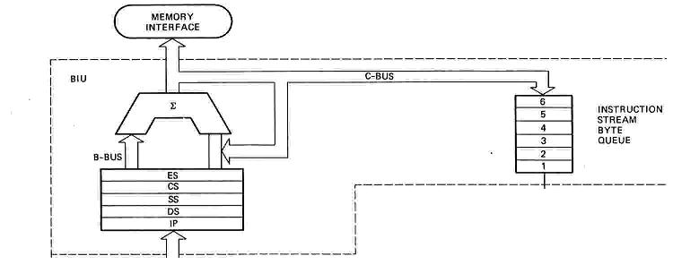
BUS INTERFACE UNIT (BIU)
Contains
6-byte Instruction Queue (Q)
The Segment Registers (CS, DS, ES, SS).
The Instruction Pointer (IP).
The Address Summing block (Σ)

Slide 17
THE QUEUE (Q)
The BIU uses a mechanism known as an instruction stream queue to implement a pipeline architecture.
This queue permits pre-fetch of up to 6 bytes of instruction code. Whenever the queue of the BIU is not full, it has room for at least two more bytes and at the same time the EU is not requesting it to read or write operands from memory, the BIU is free to look ahead in the program by pre-fetching the next sequential instruction.

Slide 18
These pre-fetching instructions are held in its FIFO queue. With its 16 bit data bus, the BIU fetches two instruction bytes in a single memory cycle.
After a byte is loaded at the input end of the queue, it automatically shifts up through the FIFO to the empty location nearest the output.
The EU accesses the queue from the output end. It reads one instruction byte after the other from the output of the queue.
The intervals of no bus activity, which may occur between bus cycles are known as Idle state.

Slide 19


Segmented Memory
Physical Memory
Code segment (64KB)
Data segment (64KB)
Extra segment (64KB)
Stack segment (64KB)
00000
The memory in an 8086/88 based system is organized as segmented memory.
The CPU 8086 is able to address 1Mbyte of memory.
The Complete physically available memory may be divided into a number of logical segments.
1 MB
FFFFF

Slide 20
The size of each segment is 64 KB
A segment is an area that begins at any location which is divisible by 16.
A segment may be located any where in the memory
Each of these segments can be used for a specific function.
Code segment is used for storing the instructions.
The stack segment is used as a stack and it is used to store the return addresses.
The data and extra segments are used for storing data byte.
* In the assembly language programming, more than one data/ code/ stack segments can be defined. But only one segment of each type can be accessed at any time.

Slide 21
The 4 segments are Code, Data, Extra and Stack segments.
A Segment is a 64kbyte block of memory.
The 16 bit contents of the segment registers in the BIU actually point to the starting location of a particular segment.
Segments may be overlapped or non-overlapped
Advantages of Segmented memory Scheme
Allows the memory capacity to be 1Mb although the actual addresses to be handled are of 16 bit size.
Allows the placing of code, data and stack portions of the same program in different parts (segments) of the m/y, for data and code protection.
Permits a program and/or its data to be put into different areas of memory each time program is executed, i.e. provision for relocation may be done .
The segment registers are used to allow the instruction, data or stack portion of a program to be more than 64Kbytes long. The above can be achieved by using more than one code, data or stack segments.

Slide 22
Segment registers
In 8086/88 the processors have 4 segments registers
Code Segment register (CS), Data Segment register (DS), Extra Segment register (ES) and Stack Segment (SS) register.
All are 16 bit registers.
Each of the Segment registers store the upper 16 bit address of the starting address of the corresponding segments.

Slide 23
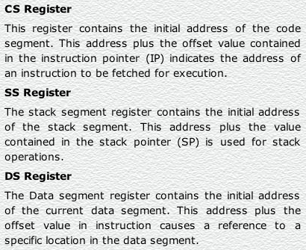
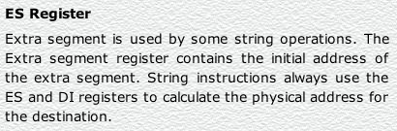

Slide 24
MEMORY
00000
BIU
Segment Registers
34BA0
CODE (64k)
44B9F
CSR
34BA
44EB
54EB
695E
44EB0
DATA (64K)
54EAF
1 MB
DSR
54EB0
ESR
EXTRA (64K)
64EAF
SSR
695E0
STACK (64K)
795DF
Each segment register store the upper 16 bit of the starting address of the segments

Slide 25
Instruction pointer & summing block
The instruction pointer register contains a 16-bit offset address of instruction that is to be executed next.
The IP always references the Code segment register (CS).
The value contained in the instruction pointer is called as an offset because this value must be added to the base address of the code segment, which is available in the CS register to find the 20-bit physical address.
The value of the instruction pointer is incremented after executing every instruction.
To form a 20bit address of the next instruction, the 16 bit address of the IP is added (by the address summing block) to the address contained in the CS , which has been shifted four bits to the left.

Slide 26
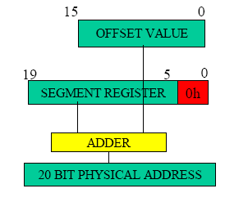

Slide 27
The following examples shows the CS:IP scheme of address formation:
CS
34BA
IP
8AB4
Code segment
34BA0
Inserting a hexadecimal 0H (0000B)
with the CSR or shifting the CSR
four binary digits left
8AB4 (offset)
3D654
3 4 B A 0 ( C S ) +
8 A B 4 ( I P )
3 D 6 5 4 (next address)
44B9F

Slide 28
Example For Address Calculation (segment: offset)
If the data segment starts at location 1000h and a data reference contains the address 29h where is the actual data?
Offset
0000 0000 0010 1001
Segment Address
0001 0000 0000 0000
0000
0001 0000 0000 0010 1001
Required Address

Slide 29
Segment and Address register combination
CS:IP
SS:SP SS:BP
DS:BX DS:SI
DS:DI (for other than string operations)
ES:DI (for string operations)

Slide 30
Summary of Registers & Pipeline of 8086 µP
EU
BIU
AX
AH | AL
BH | BL
CH | CL
DH | DL
IP
BX
D
E
C
O
D
E
R
Fetch & store code bytes in PIPELINE
CX
CS
DS
ES
SS
DX
CODE OUT
CODE IN
PIPELINE
(or)
QUEUE
IP
BX
DI
SP
SP
BP
SI
DI
DI
BP
SI
Timing
control
Default Assignment
FLAGS
ALU

